Slide 1
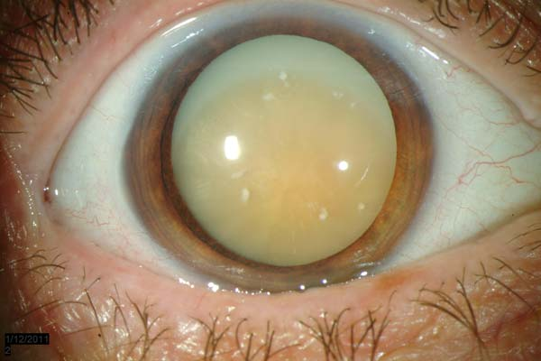
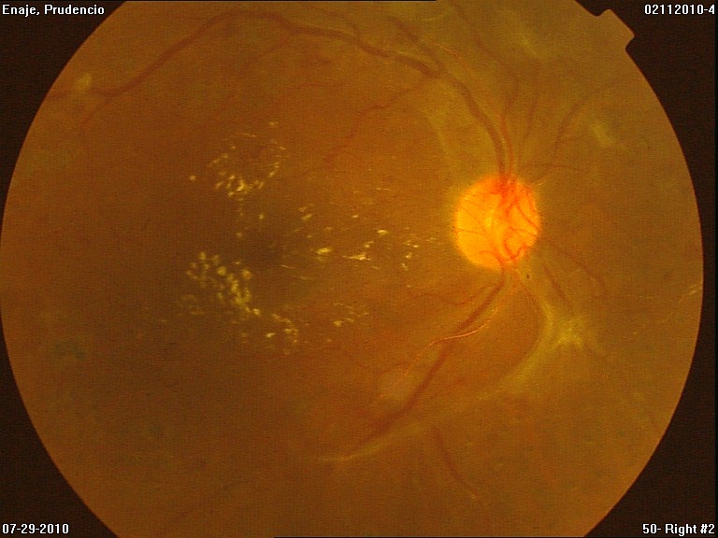
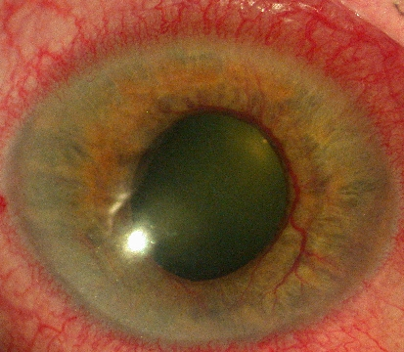
Diabetic eye screening what every doctor should know
August Sight Saving Month 2016

Slide 2


FIGHT DIABETIC BLINDNESS
August Sight Saving Month 2016
Philippine Academy of Ophthalmology
Vitreo-Retina Society of the Philippines

Slide 3
Epidemiology : diabetes MELLITUS
The total number of people with diabetes is projected to rise from 285 million in 2010 to 439 million in 2030.
http://www.who.int/bulletin/volumes/82/11/en/844.pdf
http://www.ncbi.nim/nih.gov/pubmed/19896746

Slide 4
Epidemiology: DIABETIC RETINOPATHY
Diabetic retinopathy is responsible for 1.8 million of the 37 million cases of blindness throughout the world
http://www.who.int/bulletin/volumes/82/11/en/844.pdf
http://www.ncbi.nim/nih.gov/pubmed/19896746

Slide 5
BLINDNESS FROM DIABETES
Diabetes mellitus is the most common cause of blindness amongst individuals of working-age ( 20-65 years).
http://www.who.int/bulletin/volumes/82/11/en/844.pdf
http://www.ncbi.nim/nih.gov/pubmed/19896746

Slide 6
Blindness from diabetes
USA
  Diabetes is the leading cause of new cases of blindness among adults ages 20–74 years.
  28.5 % people with diabetes ages 40 years or older had diabetic retinopathy
  4.4 percent of those with diabetes—had advanced diabetic retinopathy that could lead to severe vision loss
Philippines
  1269 diabetics screened
    49% had abnormal eye findings;
    28% with diabetic retinopathy (22% background; 6% pre and proliferative)
    28% with cataract.
Clinical Diabetes 2009; Oplan Silip Mata 2001

Slide 7
Local data
WHO Situational Analysis on Diabetic Retinopathy and Diabetes Management Systems (Cubillan et al, unpublished data)
  54 out of 1000 Filipinos are diabetic, based on a cutoff of 126 mg/dl (prevalence of 5.4%)
  2 out of the 54 diabetic patients have DM retinopathy (prevalence of 4%)
2006 Study
  Prevalence of DM retinopathy among newly-diagnosed Type 2 DM patients was 12%
2002 National Blindness Study
  DM retinopathy is the 3rd most common cause of blindness (14%), after cataract (56%) refractive error (17%) and tied with glaucoma (14%)

Slide 8
Burden of disease
Patients afflicted with Vision-threatening Diabetic Eye Disease are in their economically productive years
  Quality of life of the patient and his/her caregiver
  Loss opportunity for patient and care giver
  Drain on resources (patient, family, private and government institutions)

Slide 9
Diabetic eye disease
Tear film dysfunction
Corneal epithelial erosions
Error of refraction
Cataracts - temporary disability
Vitreous degeneration
Retinopathy – permanent disability
Glaucoma – permanent disability

Slide 10
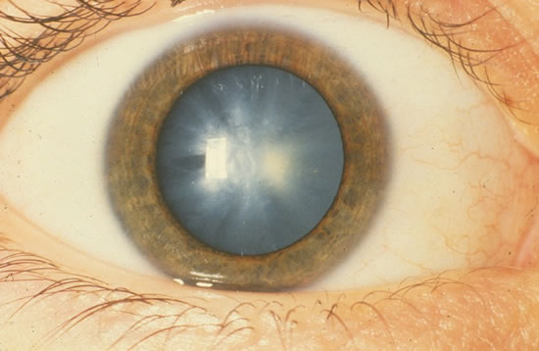
cataract
Cataract formation is part of the aging process and everyone will eventually develop it
  Diabetics are at risk of developing cataract earlier
    High glucose causes osmotic stress on lens fibers and lens epithelial cells causing clouding of the lens
  Not an urgent condition- will not lead to permanent blindness, but needs occassional check-up
  Usually symptomatic

Slide 11
glaucoma
  Neovascular Glaucoma
    sequalae of neglected diabetic retinopathy
    obstruction/occlusion of the TM by neovascular network that develops due to retinal ischemia
Can cause permanent blindness if not detected early and managed appropriately
Iris new vessels

Slide 12
Diabetic Retinopathy
  Chronic and persistently high blood glucose
    endothelial damage of retinal capillaries
    microvascular occlusion
    retinal ischemia
    retinal neovascularization – detrimental to retina
If not detected early and managed at the right time – can cause permanent blindness
May be asymptomatic at the stage when treatment effect is optimal

Slide 13
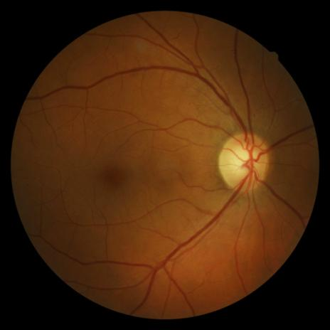
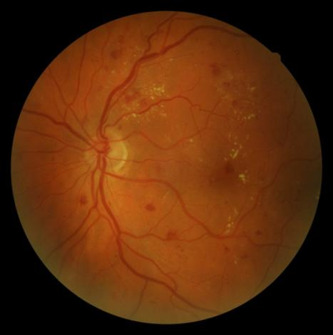
MODERATE
DIABETIC RETINOPATHY
More Advanced
Diabetic Retinopathy
Normal Retina
HEMORRHAGES AND EXUDATES
MODERATE NON-PROLIFERATIVE DIABETIC RETINOPATHY
HEMORRHAGES, EXUDATES NEOVASCULARIZATION , FIBROVASCULAR PROLIFERATION
PROLIFERATIVE DIABETIC RETINOPATHY

Slide 14
Diabetic Retinopathy Risk Factors
Poor Glycemic control (HBAIc level)
Wisconsin Epidemiologic Study of Diabetic Retinopathy (WESDR)
  Glycemic control is the most important risk factor for the incidence and progression of DR
  Strong statistical correlation between glycemic control and progression of retinopathy in all severity stage
Diabetes Control and Complication Trial (DCCT)
  Intensive glycemic control reduces risk of developing DR by 76%
  Intensive glycemic control reduces risk of progression by 54%
  35-40% reduction in risk of progression for every 10% decrease in HbA1C

Slide 15
Diabetic Retinopathy Risk Factors
  Longer Duration of diabetes
  Wisconsin Epidemiologic Study of Diabetic Retinopathy (WESDR)
  After 20 years of diabetes, nearly 99% of patients with type 1 diabetes and 60% with type 2 have some degree on diabetic retinopathy
  33% of patients with diabetes have signs of diabetic retinopathy
  People with diabetes are 25 times more likely to become blind than the general population

Slide 16
Diabetic Retinopathy Risk Factors
  Presence of Comorbidity :
  Hypertension, Hyperlipidemia
United Kingdom Prospective Diabetes Study (UKPDS)
  25% reduction in risk in microvascular complication with intensive glycemic control
  For every % point decrease in HbA1C there was a 35% reduction in risk of microvascular complication
  Tight BP control resulted in 37% reduction in microvascular complication

Slide 17
ETDRS Classification
Non-Proliferative Diabetic Retinopathy
  Mild
  Moderate
  Severe
  Very Severe
Proliferative Diabetic Retinopathy
  Early
  High Risk

Slide 18
Risk of Progression and Ff-up Recommendation
Risk of Progression to | Mild NPDR | Moderate NPDR | Severe NPDR | VSevere NPDR
PDR (1yr) | 5% | 12-27% | 52% | 75%
HR (5yrs) (High Risk for Vision Loss) | 15% | 33% | 60% | 75%
Follow up | 6-12 mos | 4-8 mos | 2-4 mos | 2-3 mos

Slide 19
symptoms
None
Dry Eye symptoms
Blurring of vision
“Floaters”
Eye Pain and redness
“Good vision does not equate to normal eye findings”

Slide 20
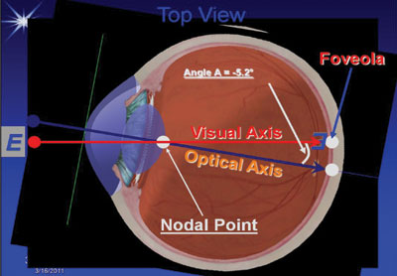
Why good vision does not equate to Normal eye findings
Vision is only affected if there is a problem in the visual axis.
Lesions in the peripheral retina are usually asymptomatic

Slide 21
If vision is already affected most of the time the eye complication is already advanced
  Loss vision cannot be restore
  Can only preserve the remaining vision
The retina is a neural tissue and damage is IRREVERSIBLE

Slide 22
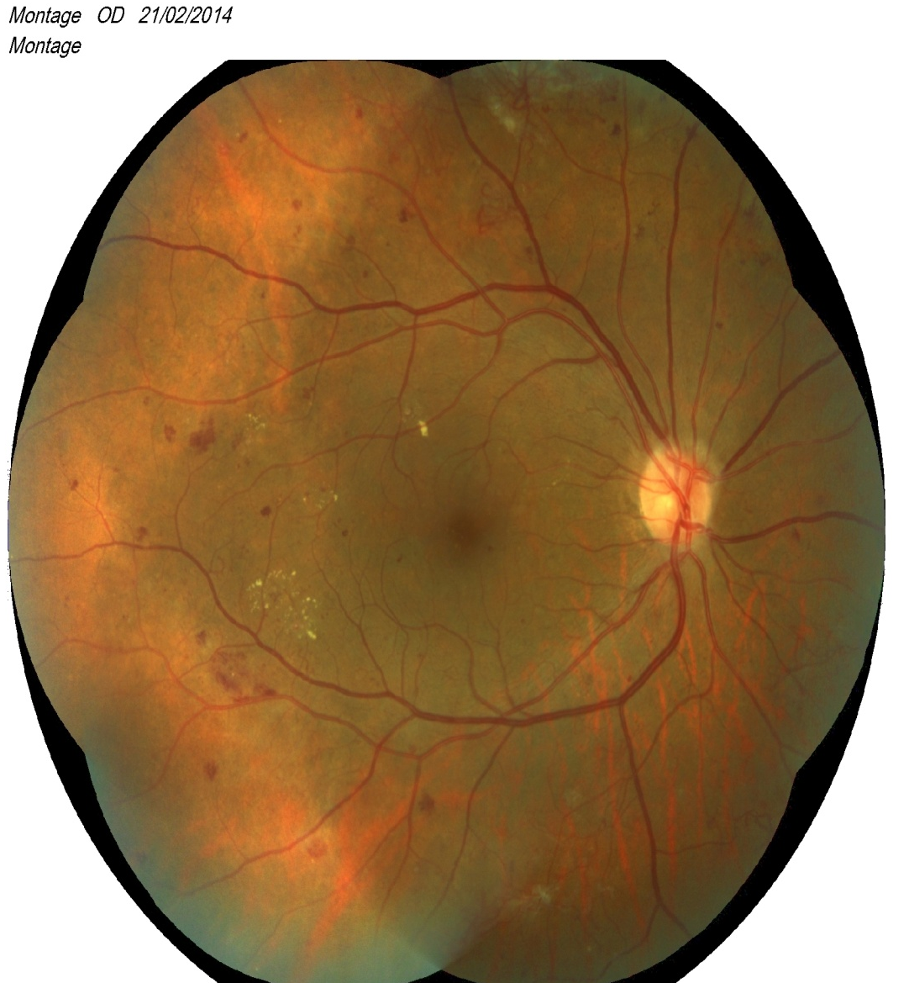

A.N. 49/F bcVA OU 20/20 8 yrs DM no eye complaint – referred for Screening
DIABETIC RETINOPATHY MORE ADVANCED ATAGES
(PROLIFERATIVE DIABETIC RETINOPATHY)
RIGHT EYE
LEFT EYE
NEW VESSEL FORMATION (NEOVASCULARIZATION
Notes:
Case of 49/F diabetic for 8 years, referred for Retina screening. Px has no eye complaints. Vision was 20/20. Fundus exam shows Proliferative Diabetic Retinopathy.

Slide 23
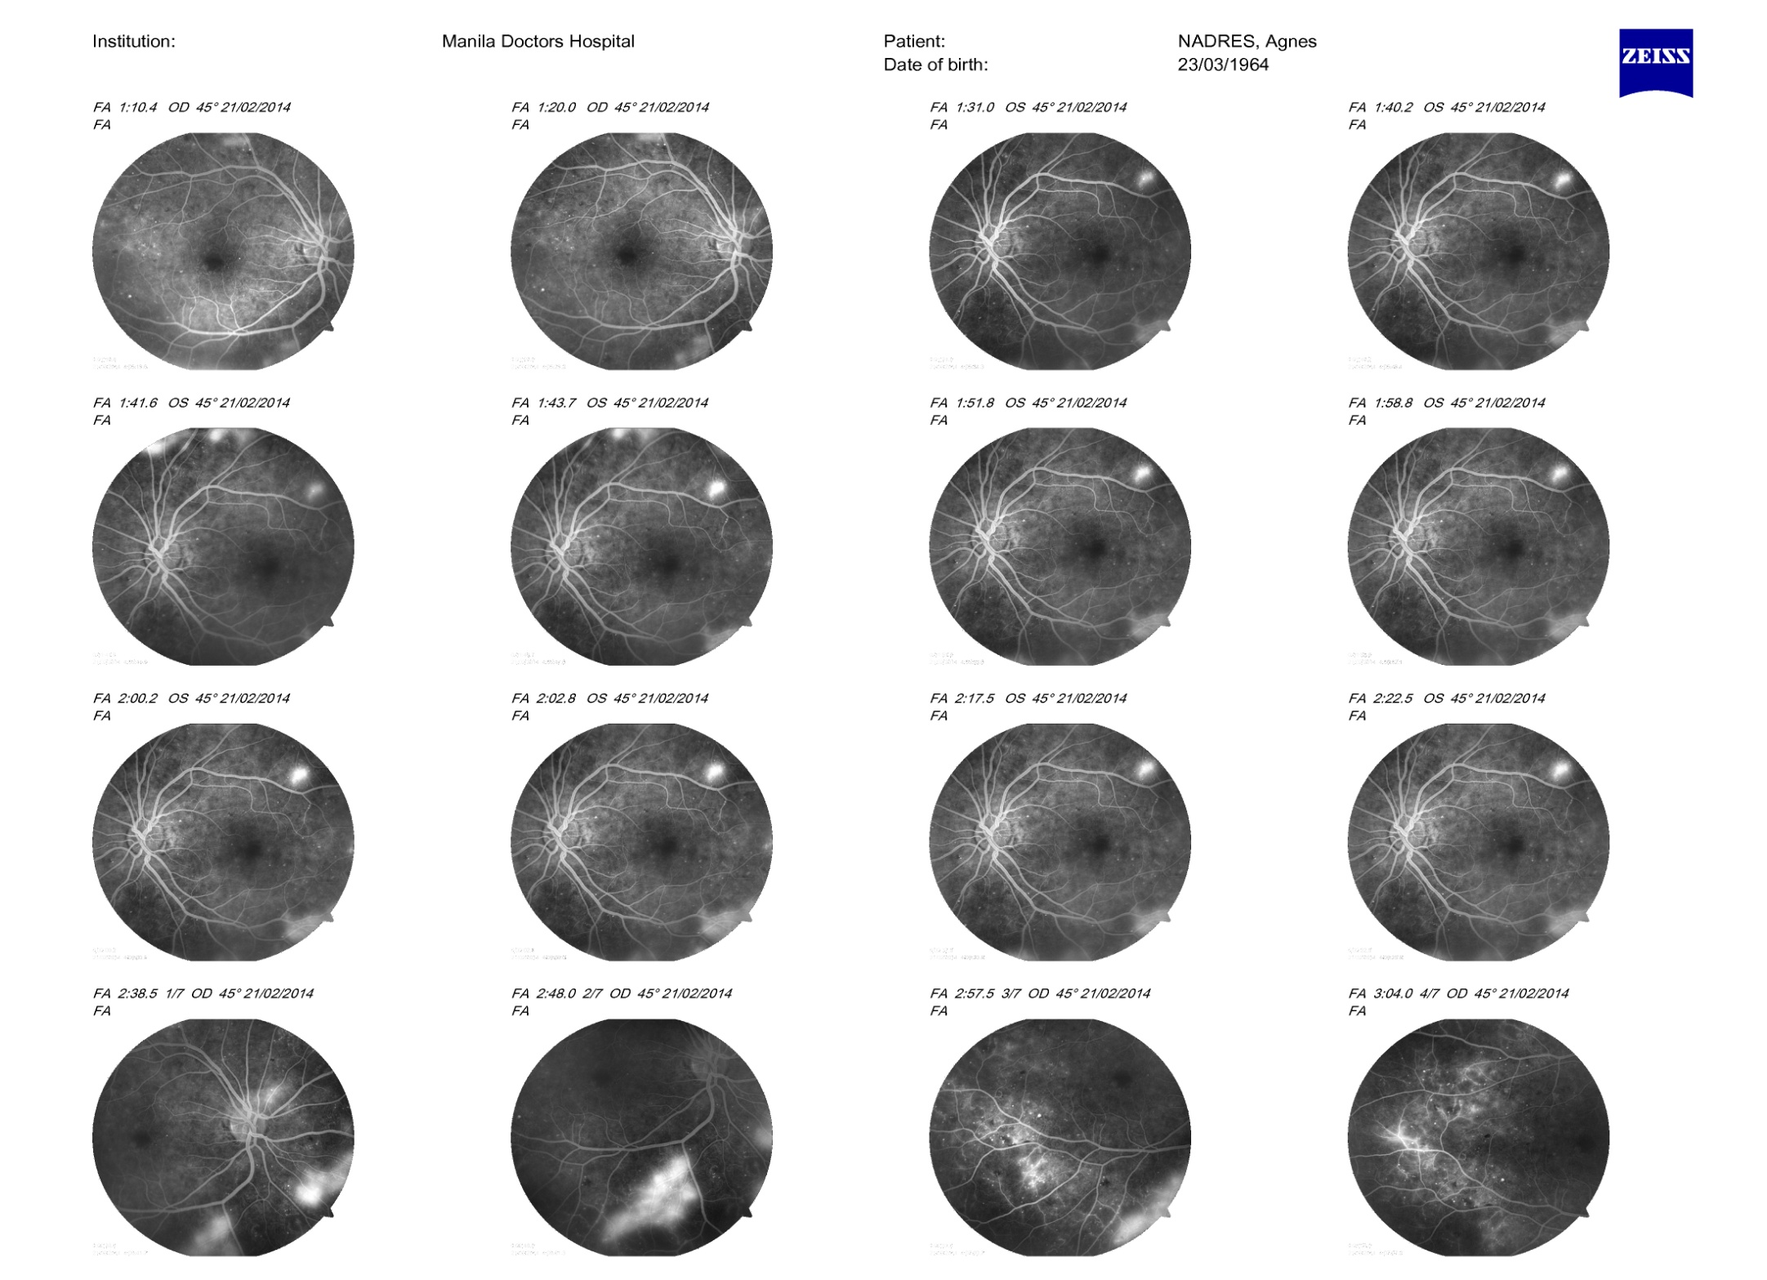
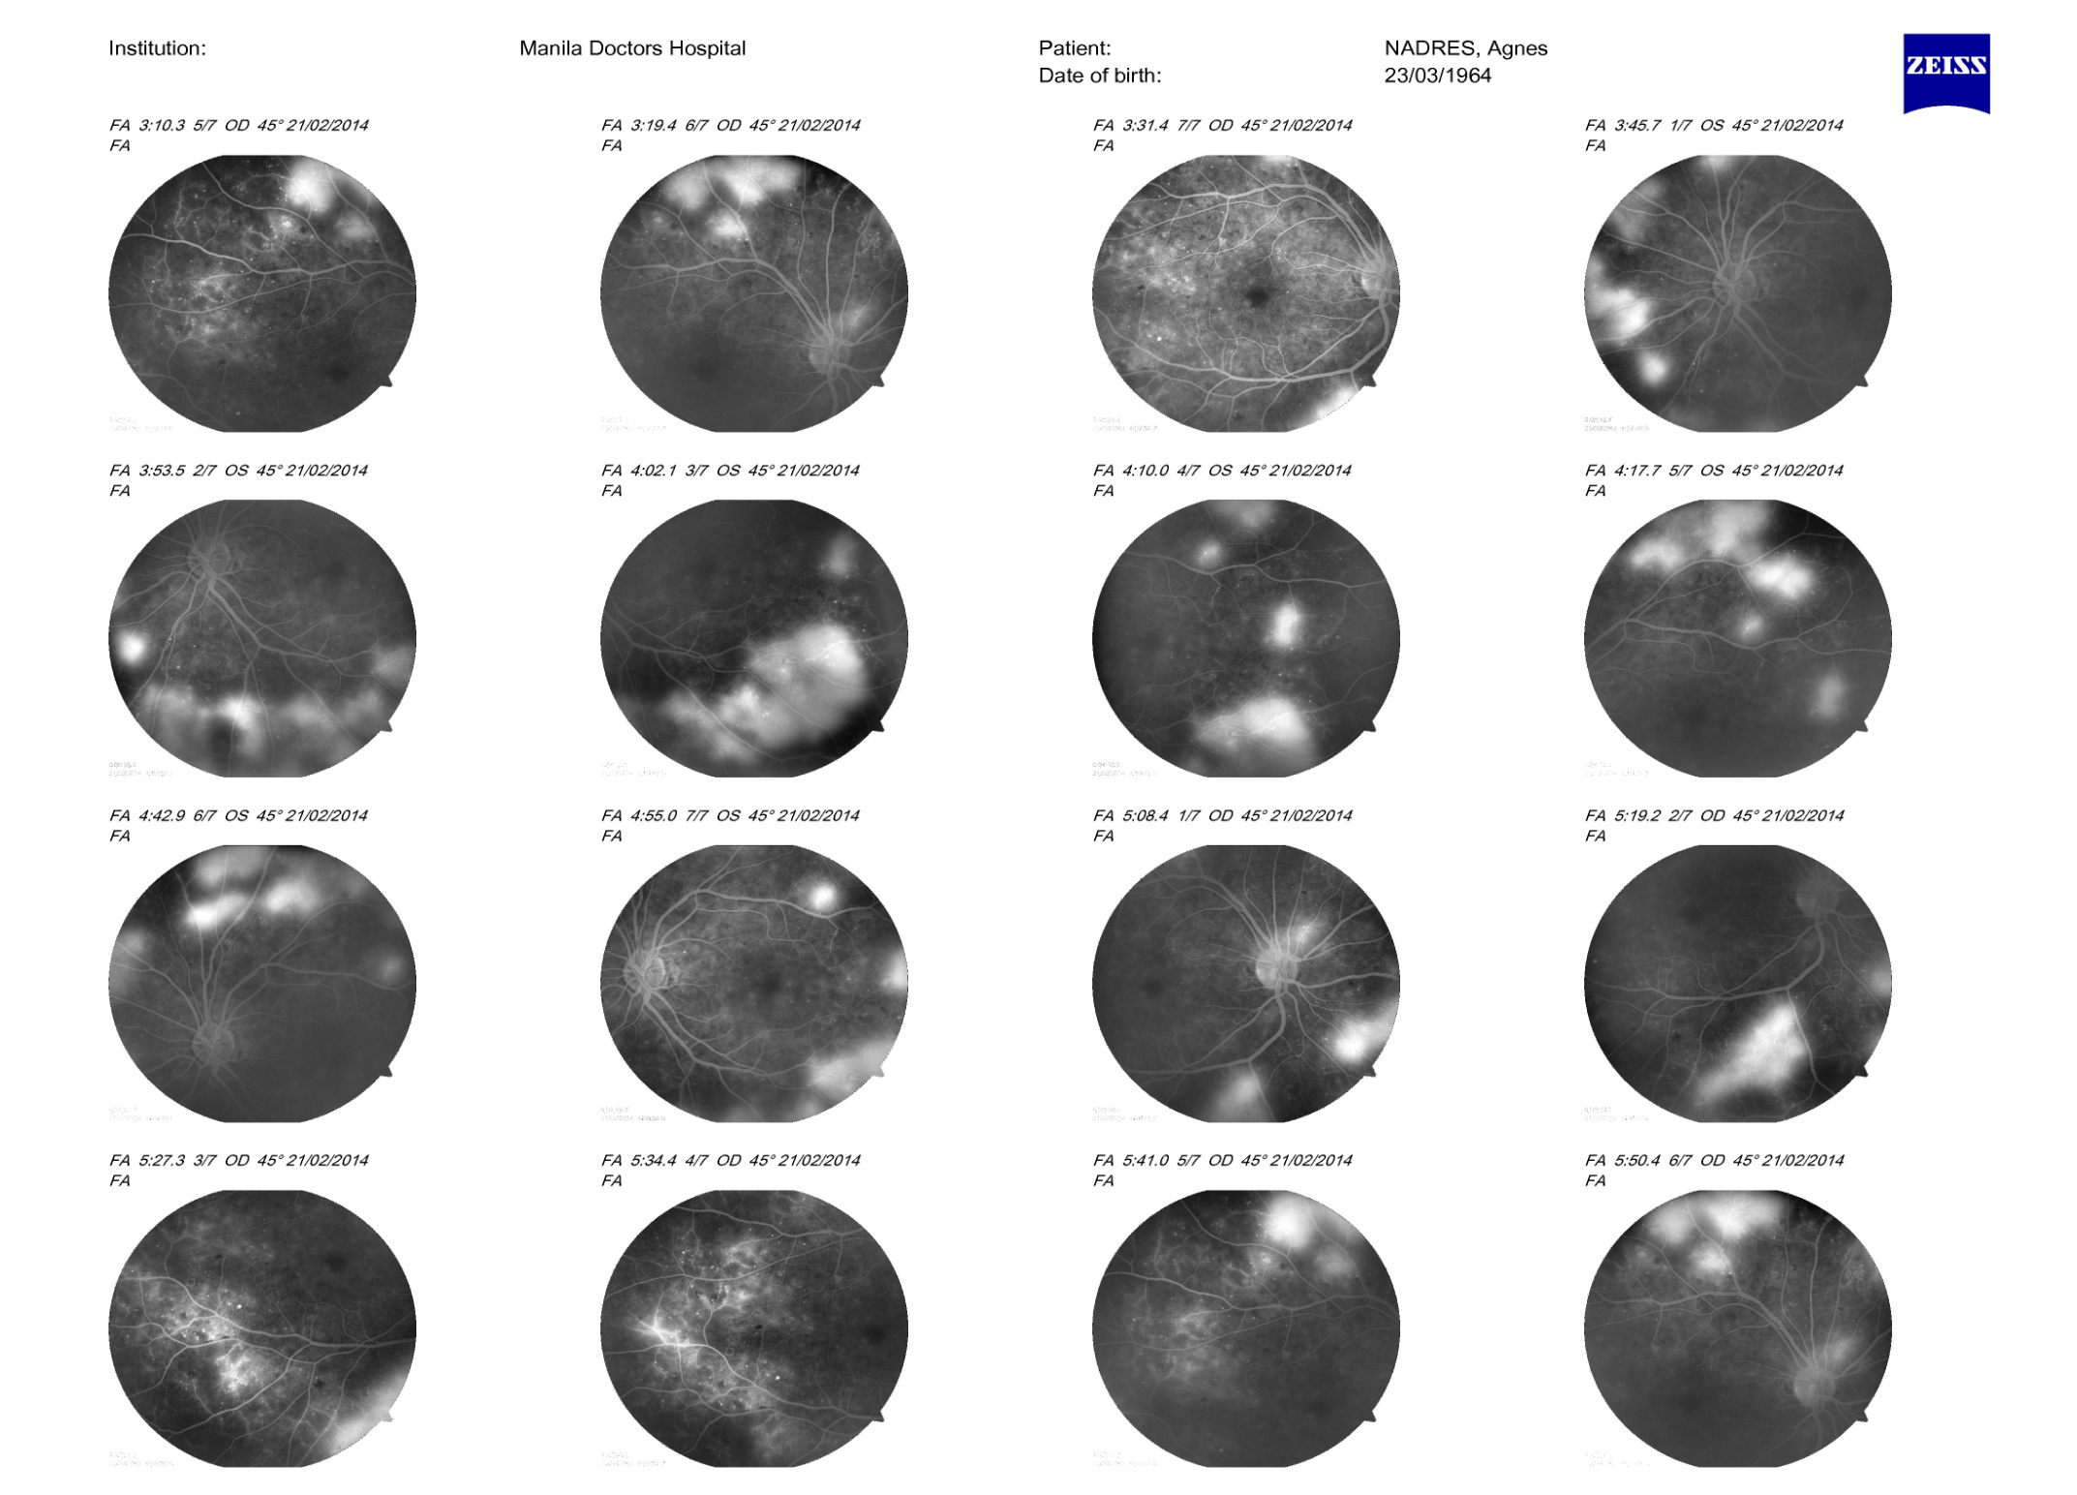
RIGHT EYE
FLUORESCEIN DYE LEAKAGE from new vessels
LEFT EYE
Notes:
Abnormal neovascularization more evident on angiography.

Slide 24
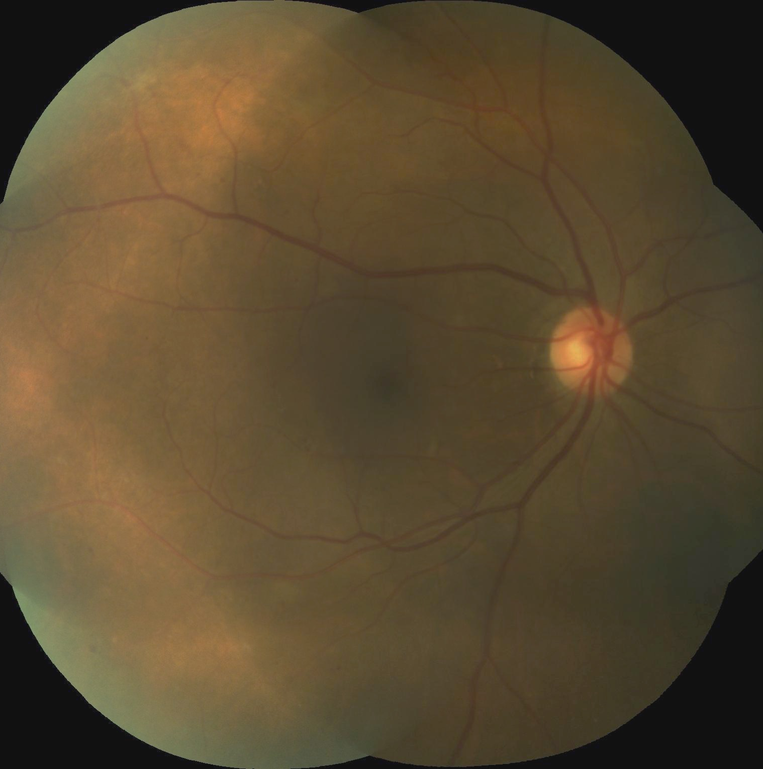
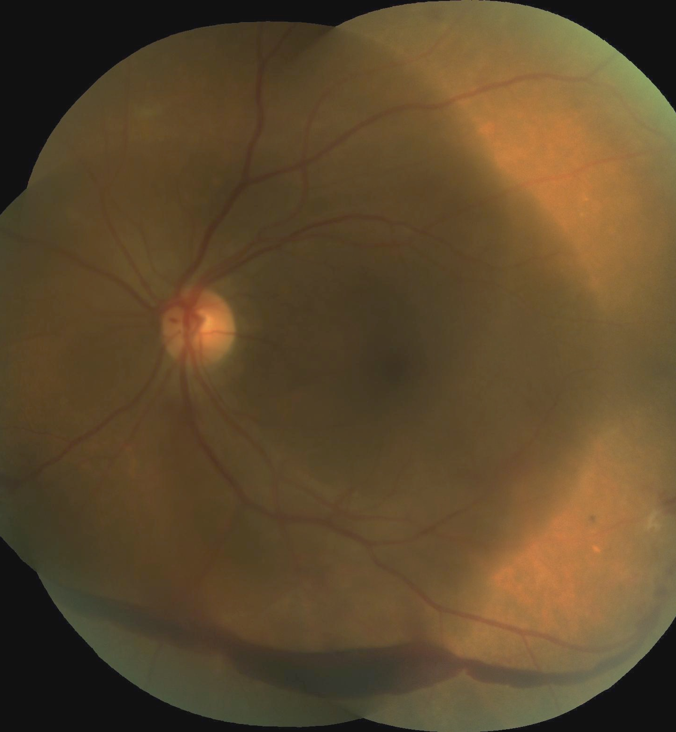
EF 56/F VAOD 20/20 2 wks “floaters” OS
OS 20/40 20 yrs DM
RIGHT EYE
LEFT EYE
Diabetic Retinopathy in the more advanced “Proliferative” Stage on first consult
PRE-RETINAL HEMORRHAGE
Notes:
56/F 20 years diabetic who consulted due to “floaters” in the left eye. Vision in the right eye 20/20; left eye 20/40. Retina findings show featureless (peripheral retinal vessels not as distinct) in the right eye and a pre-retinal hemorrhage in the left eye

Slide 25
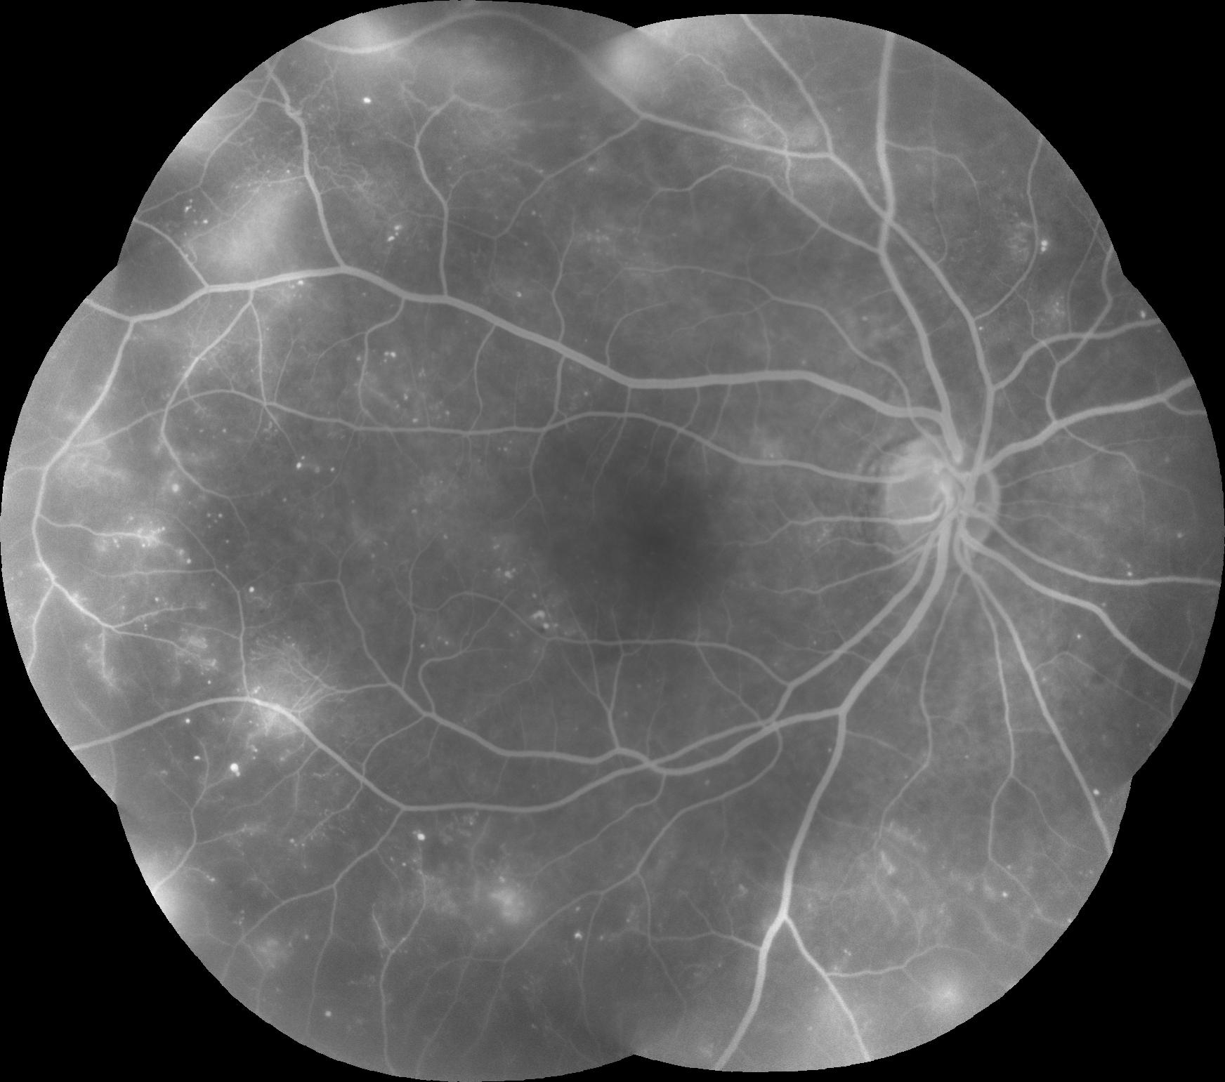
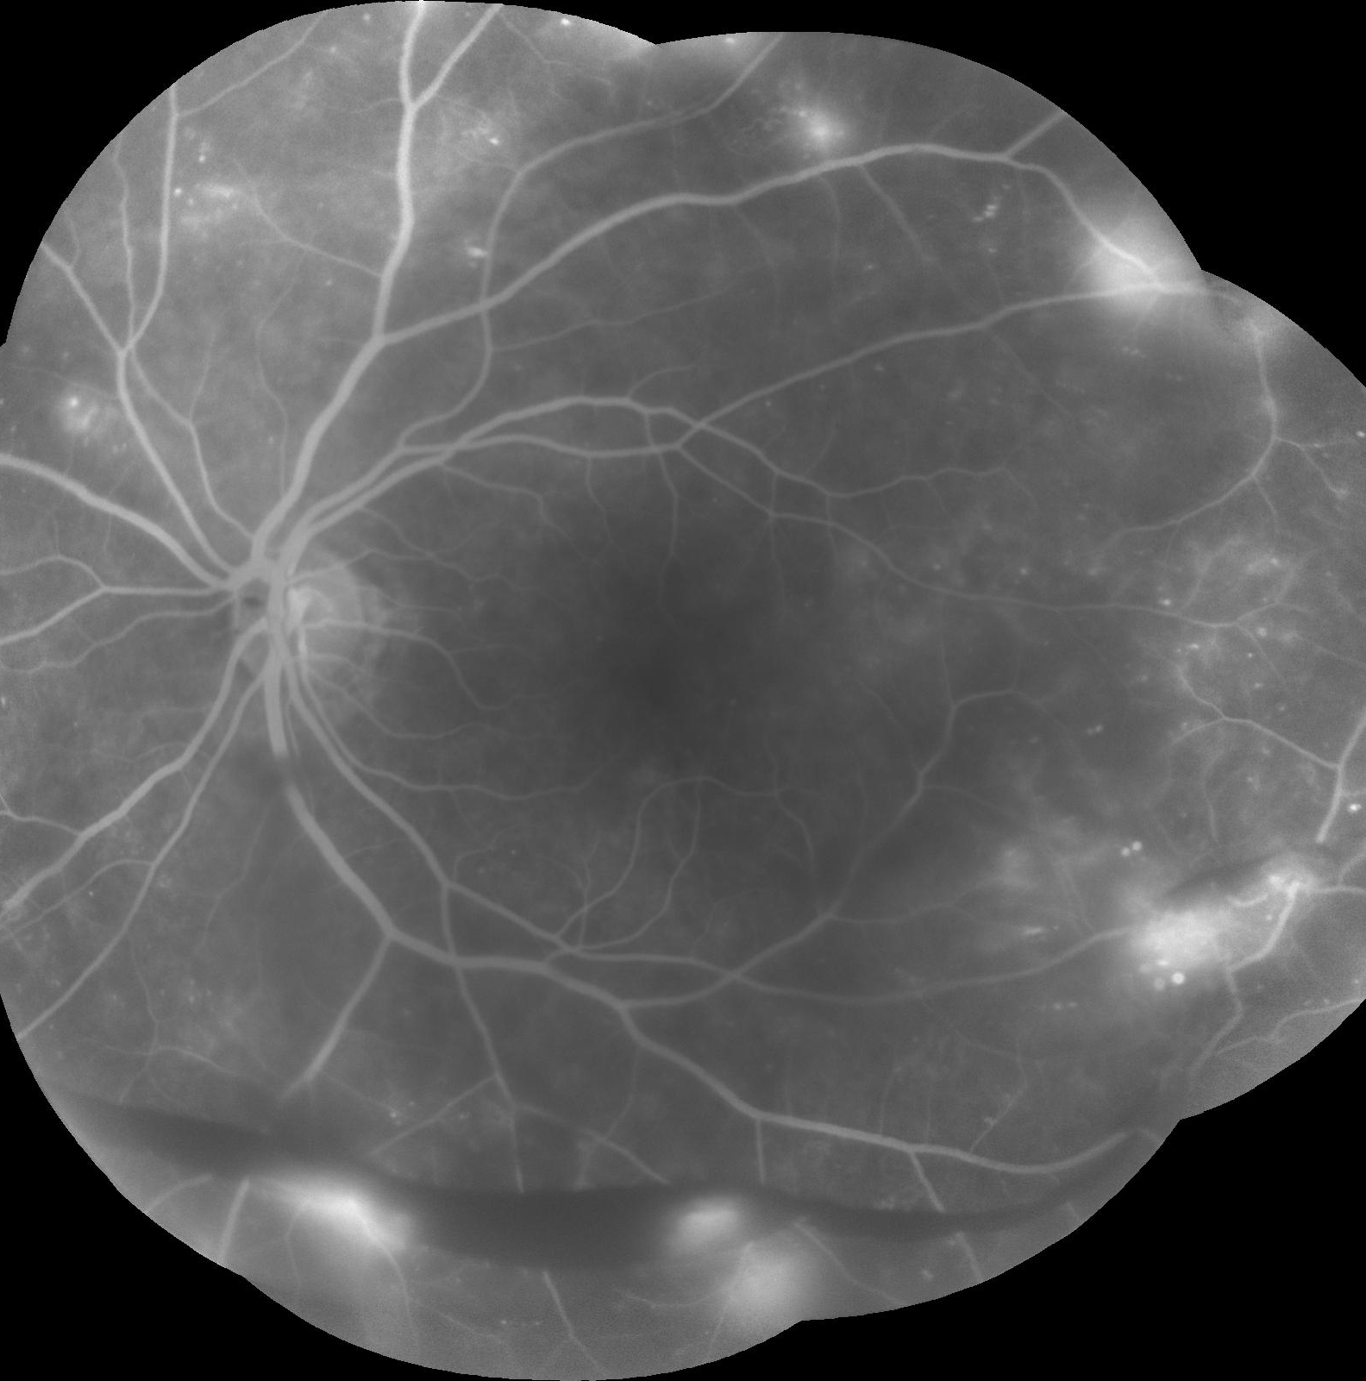
OD PDR early OS PDR High Risk
Fluorescein Dye leakage from neovascularization which caused hemorrhage
Notes:
Angiography of the eye confirms retinal ischemia and neovascularization in both eyes

Slide 26
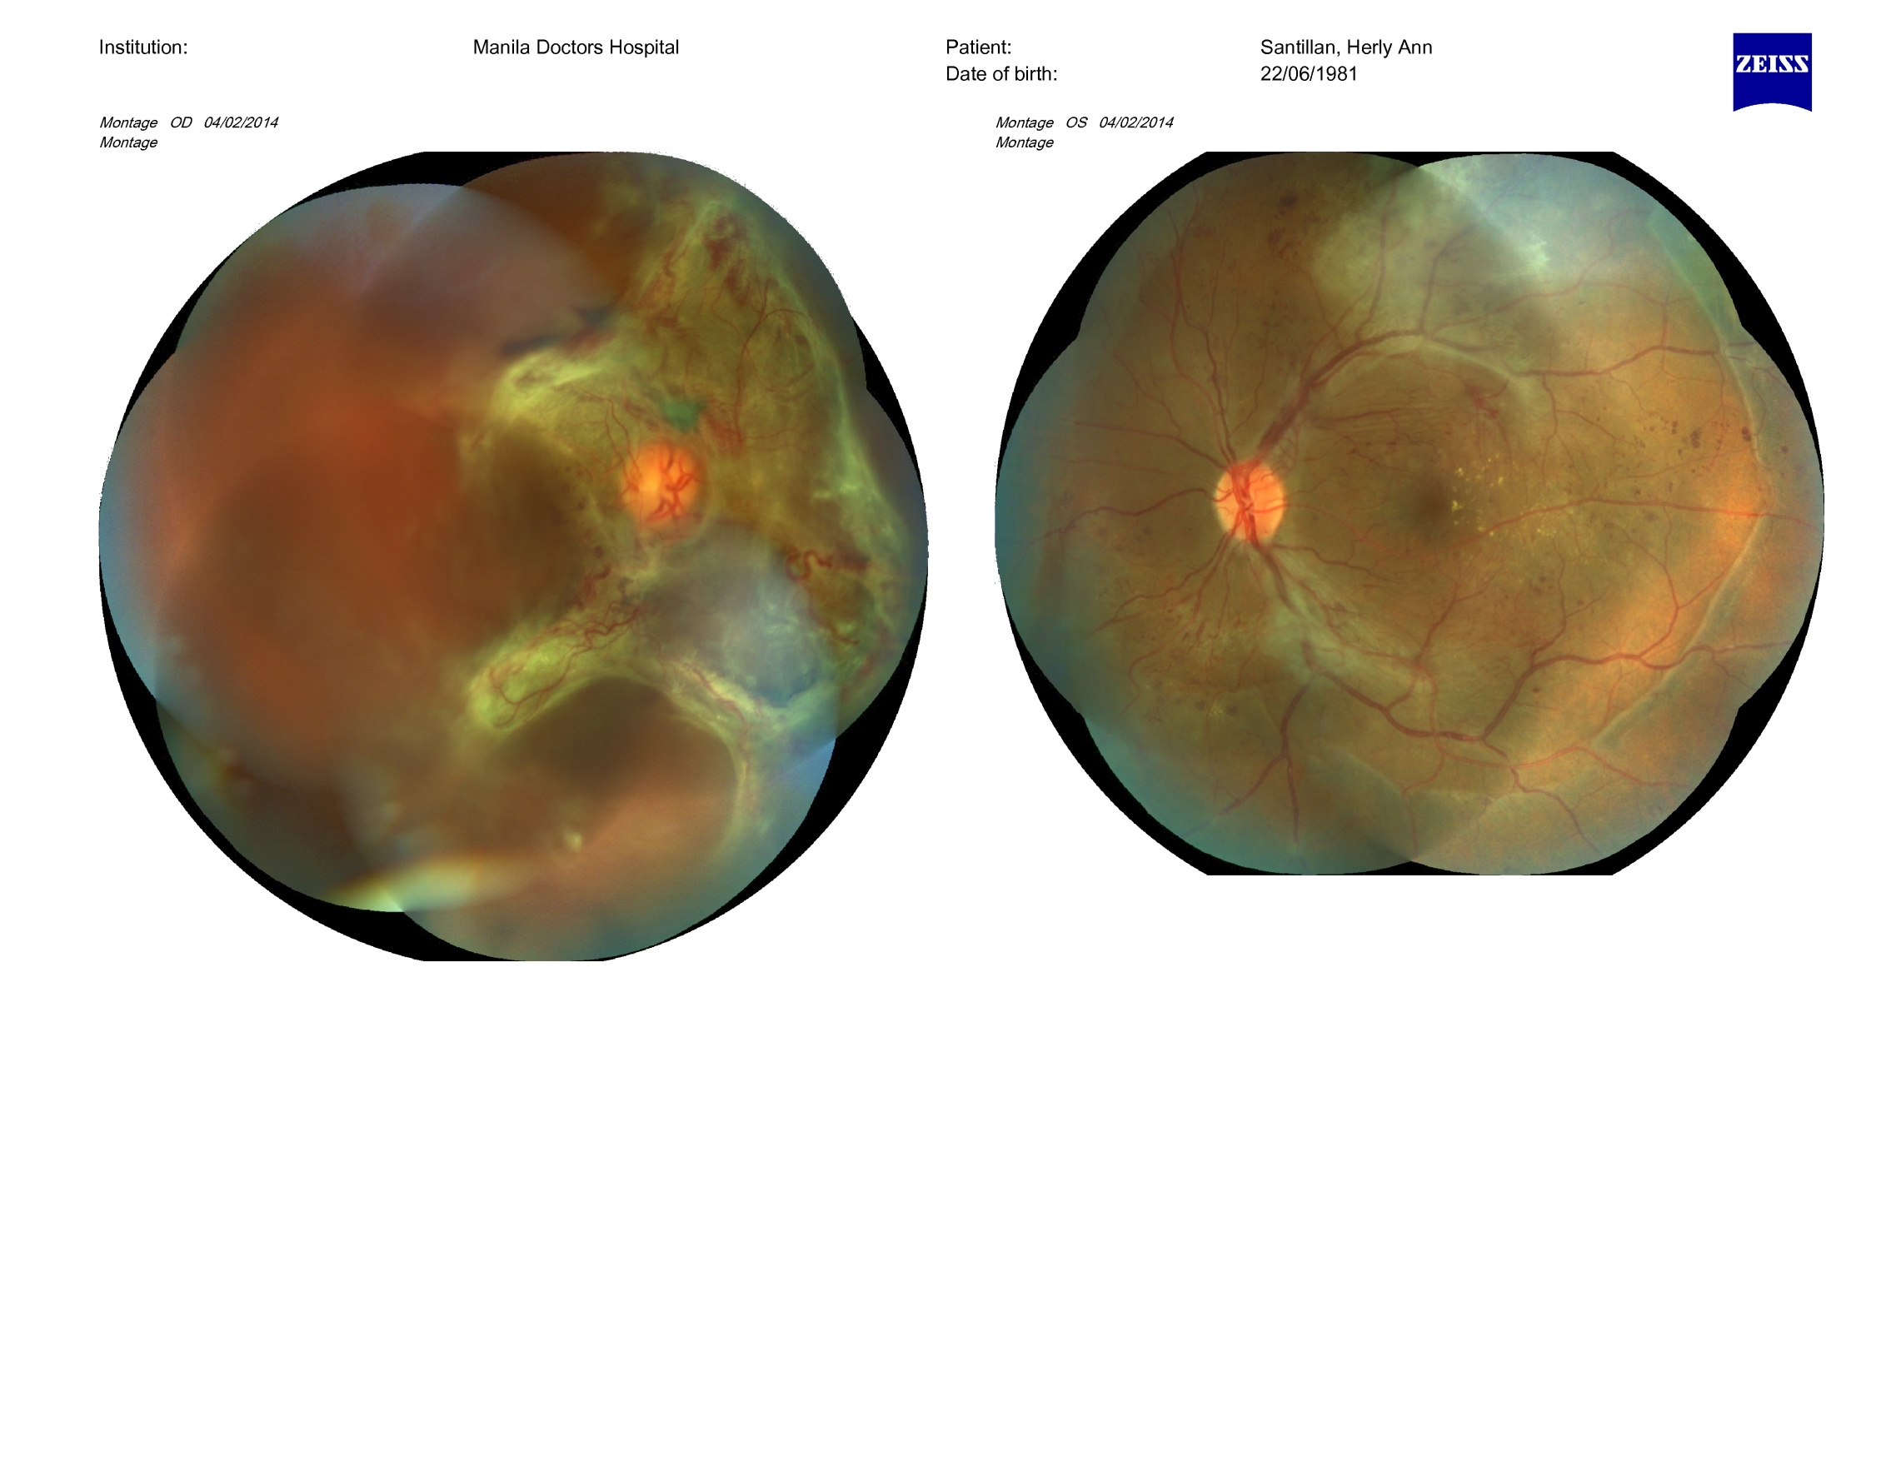
H.S. 35/F VA OD HM recent dx dm
OS 20/40 (after eye exam)
Fibrovascular Proliferation,
Vitreous Hemorrhage
Diabetic Retinopathy in the more advanced “Proliferative” Stage on first consult
Notes:
Case of 35/F who noted blurring of vision on her right eye. On consult Proliferative Diabetic retinopathy was noted in both eye. Px was insistent she was not diabetic but on work-up was diagnosed with Diabetes.

Slide 27
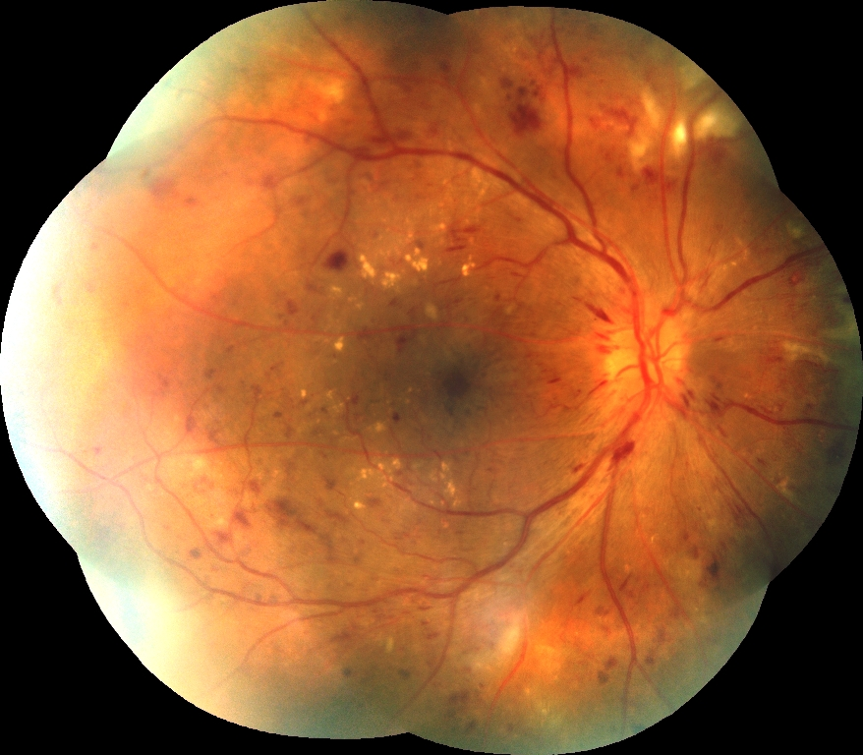
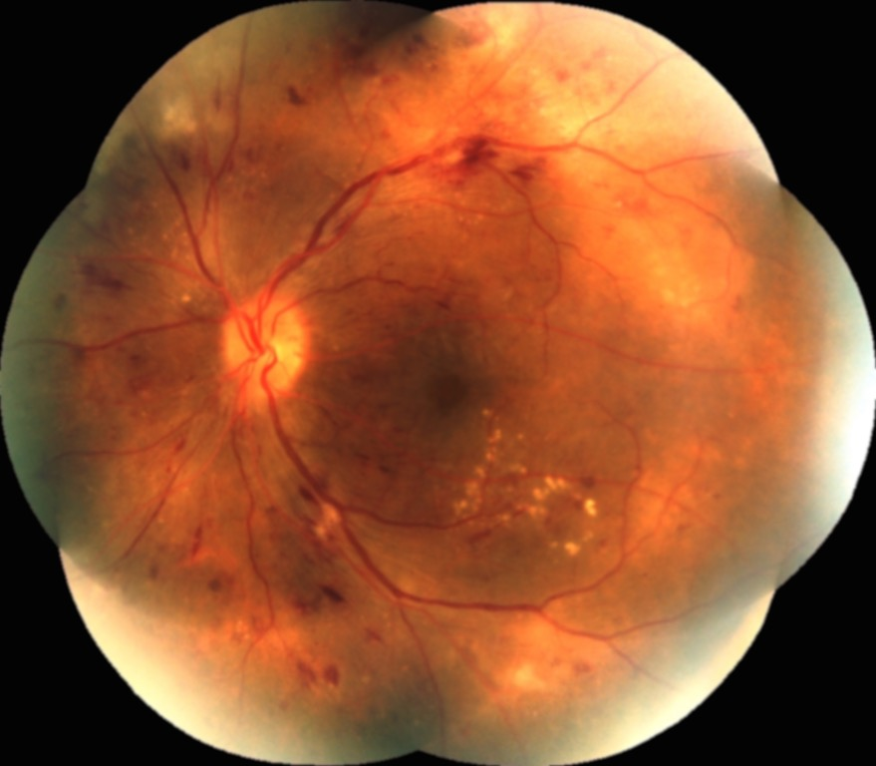
RR 54/M BCVA OU 20/40 DM x 4 years
Diabetic Retinopathy (NPDR) SEVERE, OU : advised PRP(laser) but lost to FFup
Hemorrhages
Exudates
Ischemic spots
February 9, 2014
Notes:
Case of 54/M with 4 year hx of diabetes consulted due to blurring of vision. BCVA was 20/40. He was advised Pan Retinal Photocoagulation since blood sugar was not controlled and DMR staging was NPDR severe. Px was lost to ff-up and returned 1 year later due to progression of BOV. Next slide shows worsening of retinopathy

Slide 28
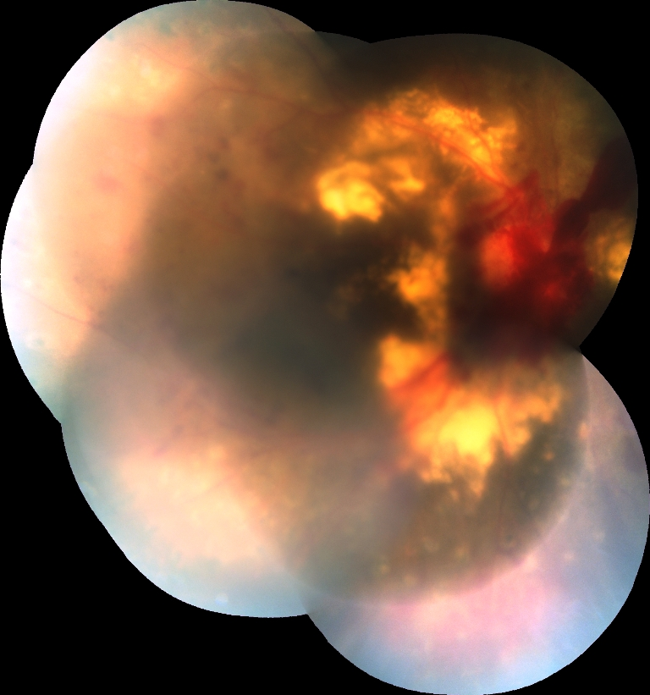
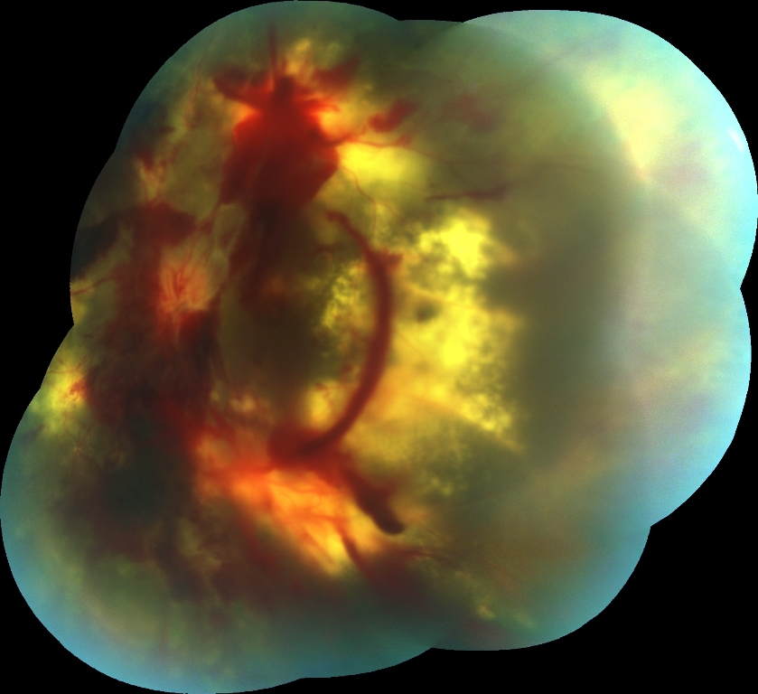
Same patient as previous slide: 1 year later
Visual Acuity: OU CF
Diabetic Retinopathy advanced “Proliferative” stage (PDR)
1 year later: February 3, 2015
Clumps of hemorrhage
Thick exudates
Dense fibrovascular proliferation
Notes:
Same px 1 year later with pre-retinal hemorrhaging and neovascular glaucoma

Slide 29
Eye Exam & Diagnostics
Basic ophthalmologic exam plus a dilated retina exam (indirect ophthalmoscopy or slit lamp + wide field retinal lenses)
Fundus photo
Fundus Fluorescein Angiography
Optical Coherence Tomography
Ultrasound

Slide 30
Eye screening
Whether patient is symptomatic or not eye screening should be done
CHANGING EYEGLASSES IS NOT ENOUGH
Remember good vision does not mean normal eye findings
Ophthalmologist cannot reverse damage of diabetes to the eye. Our goal is to prevent further deterioration and preservation of vision.
Best is to catch the eye problem before vision is affected

Slide 31
Recommended eye screening schedule
DM diagnosed before 30 years of age
    First exam : 5 yrs after dx of DM or at puberty
    Min. follow-up : yearly (more frequent if advanced stage)
DM diagnosed at 30 yrs of age or older
    First exam : at time of DM diagnosis
    Min. follow-up : yearly (more frequent if advaced stage)

Slide 32
Recommended eye screening schedule
Gestational Diabetics are not at risk for Diabetic retinopathy and screening not necessary unless they develop frank Diabetes
Pregnant with pre-existing diabetes
  First exam : prior to pregnancy for counseling
  : early in the 1st trimester
  Min ff-up : each trimester
  : more frequent as indicated
  : until 6 mos postpartum

Slide 33
Treatment options
Cataract
  cataract surgery if opacity is significant and affecting patients activity of daily living
Glaucoma
  Depends on severity
  Anti-Glaucoma drops, laser tx, glaucoma surgery

Slide 34
Treatment
Diabetic Retinopathy
  Depends on stage
  Mild-Moderate NPDR
    blood glucose control, control of other condition (HPN & Hyperlipidemia)
  Severe NPDR to PDR
    PanRetinal Photocoagulation
  Presence of Vitreous hemorrhage and/or Traction Retinal Detachment
    VitreoRetina surgery with Endophotocoagulation

Slide 35
Treatment
Intravitreal anti-VEGF (Bevacizumab, Ranibizumab, Aflibercept) adjunct to Laser treatment or retinal surgery
Best option for macular center involving macular edema – cannot/should not laser central macula

Slide 36
Laser Photocoagulation
Diabetic Retinopathy Study (DRS)
  High Risk PDR:
    Pan Retinal Photocoagulation reduces the risk of severe vision loss by 50-60%
  Severe NPDR and Early PDR,
    PRP may be considered depending on patient profile
  Severe vision loss = vision of 5/200 or less at 2 or more consecutive follow-up

Slide 37
Laser Photocoagulation
Early Treatment Diabetic Retinopathy Study (ETDRS)
  Early Photocoagulation of severe NPDR to Early PDR reduced the development of high risk PDR by 50% but not significantly change the incidence of severe vision loss
  Focal or grid laser treatment reduced the risk of moderate vision loss in patients with CSME
  Moderate vision loss = loss of 15 or more letters in the ETDRS chart
  Aspirin has no benefit nor deleterious effect on diabetic retinopathy

Slide 38
Summary
All diabetics have to be advised of possible eye complication EVEN IN THE ABSENCE OF EYE SYMPTOMS
Screening guidelines given
Goal is to PRESERVE remaining vision & control progression
Management of the eye is only temporary or useless if systemic disease is not controlled

Slide 39
FIGHT DIABETIC BLINDNESS

Slide 40
Philippine academy of ophthalmology vitreo-retina society of the philippines
THANK YOU VERY MUCH

